Slide 1
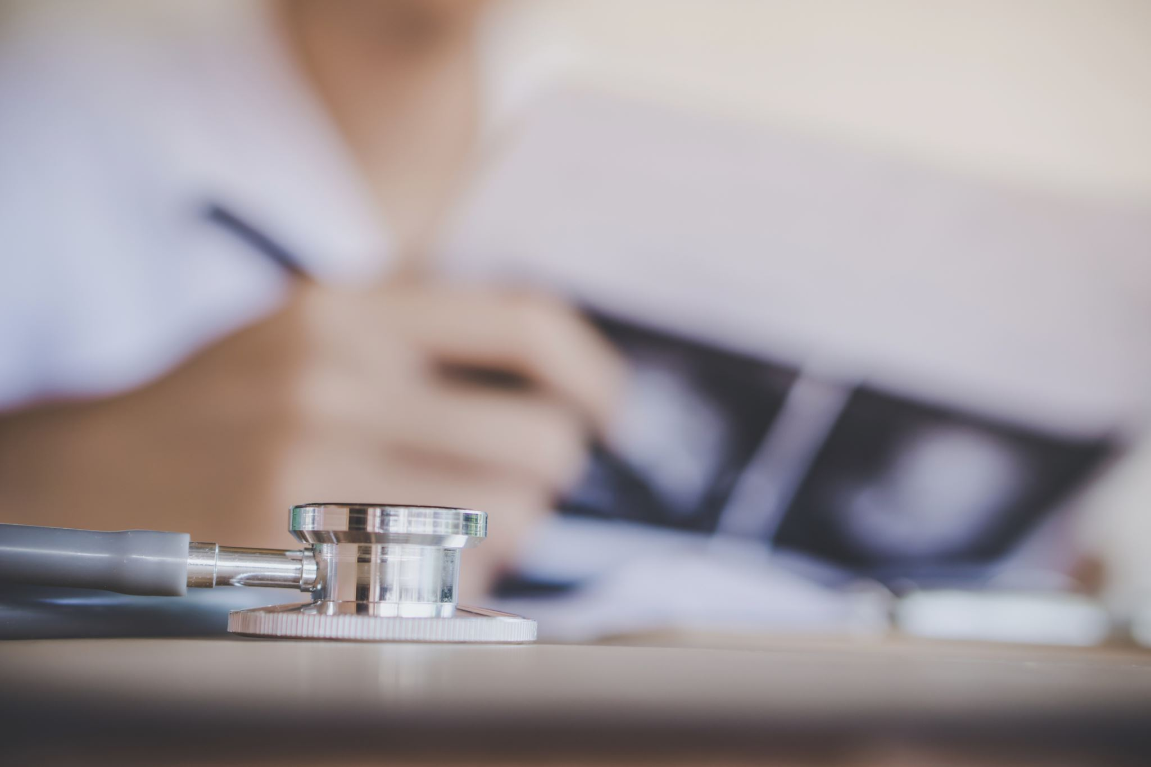

DEEP LEARNING FOR MEDICAL IMAGE DIAGNOSIS
Group Name: The Deep Learning Friends Team Members:
Sai Sravani Madabhushi
Vishanth Raj Chowhan Lavudya
Surya Shashank Pappu

Slide 2
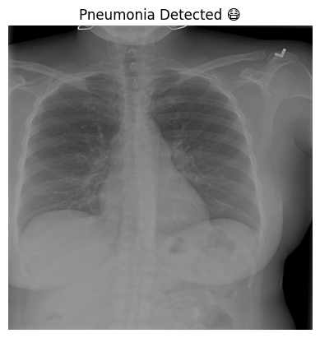
Introduction
Pneumonia continues to be a major global health challenge, especially impacting vulnerable populations such as children under the age of five and elderly individuals. Timely and accurate diagnosis is crucial but remains difficult with traditional methods like manual chest X-ray interpretation, which can be slow, subjective, and prone to human error. With the advancement of artificial intelligence, deep learning techniques—particularly CNNs have emerged as powerful tools to automate and enhance the diagnostic process. These models can rapidly and accurately identify signs of pneumonia from chest radiographs, offering a scalable solution to support healthcare providers and improve patient outcomes worldwide.

Slide 3

Abstract
Pneumonia is a leading cause of mortality worldwide, especially among young children and the elderly. Early and accurate diagnosis is critical to ensure effective treatment. Traditional diagnosis through chest X-ray interpretation by radiologists is time-consuming and vulnerable to human error, particularly in resource-constrained settings.
This project leverages Deep Learning, specifically Convolutional Neural Networks (CNNs), to automate pneumonia detection from chest X-ray images. Using transfer learning techniques, we trained and fine-tuned a CNN model to achieve high accuracy while minimizing training time.
To make the system accessible, we deployed the model through a user-friendly web application built with Streamlit, enabling real-time predictions without requiring specialized technical knowledge. Our approach demonstrates promising diagnostic performance and presents a scalable, efficient tool to assist healthcare professionals and improve medical imaging workflows.

Slide 4
Existing System
Manual X-ray analysis
CAD systems with basic ML
CNN models like CheXNet, AG-CNN
Issues: dataset dependency, sensitivity to image quality.

Slide 5
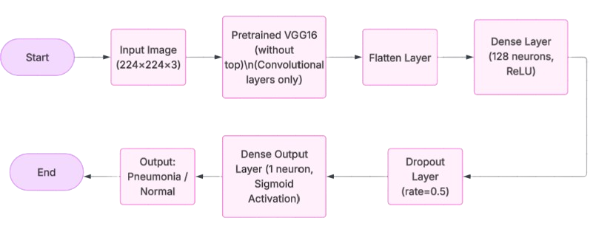
Proposed System

Slide 6
Problem Definition & Objective
Problem: Lack of radiologists and manual diagnosis errors.
Objective: Build an AI model for fast and accurate pneumonia detection with minimal false positives.

Slide 7
Design
Collected chest X-ray images (Normal and Pneumonia).
Preprocessed images: resized to 224×224 pixels, normalized.
Built a custom lightweight CNN model.
Trained model with optimized hyperparameters. Implements VGG16 transfer learning characteristics.
Evaluated using accuracy, F1-score, and confusion matrix.
Deployed model using Streamlit for real-time predictions.
Designed simple web interface for easy user interaction.

Slide 8
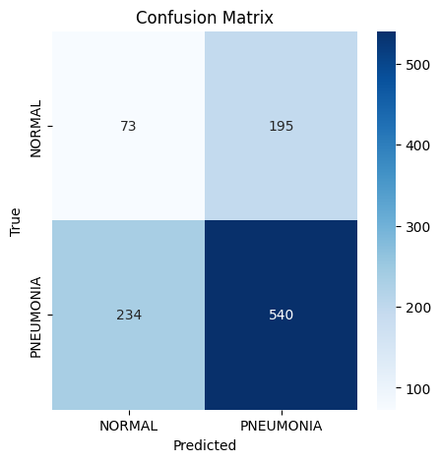
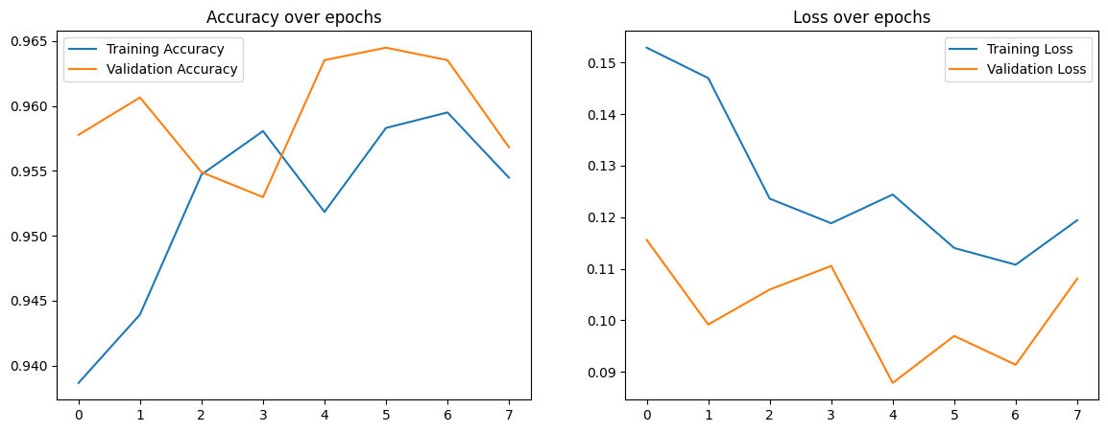
Implementation
Conducted literature review
Collected and preprocessed data
Built and trained CNN model
Evaluated with accuracy, precision, recall, F1-score.

Slide 9
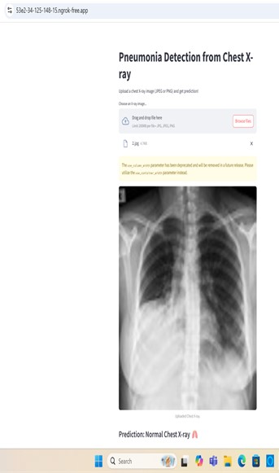
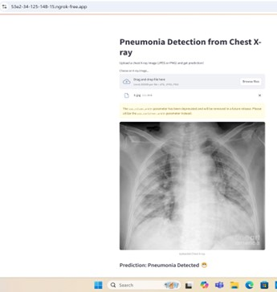
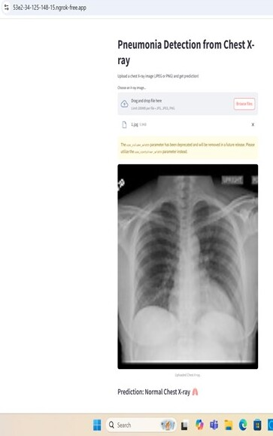
Results
detection accuracy
Enhanced performance with segmentation
Metrics aligned with research benchmarks.

Slide 10
Applications & Future Enhancements
Applications: Hospital and mobile diagnosis.
Future: Broaden disease detection, optimize for mobile, refine feature extraction.

Slide 11
Conclusion
CNN-based deep learning significantly boosts pneumonia detection accuracy. Emphasizing preprocessing and robust design is crucial. Future steps include broader applications and improving reliability across diverse populations.
Successfully developed a CNN-based model for pneumonia detection.
Achieved good training and validation performance.
Streamlit app enables real-time chest X-ray predictions.
Model helps speed up diagnosis and reduce human error.
Demonstrates strong potential for assisting healthcare systems.

